Slide 1
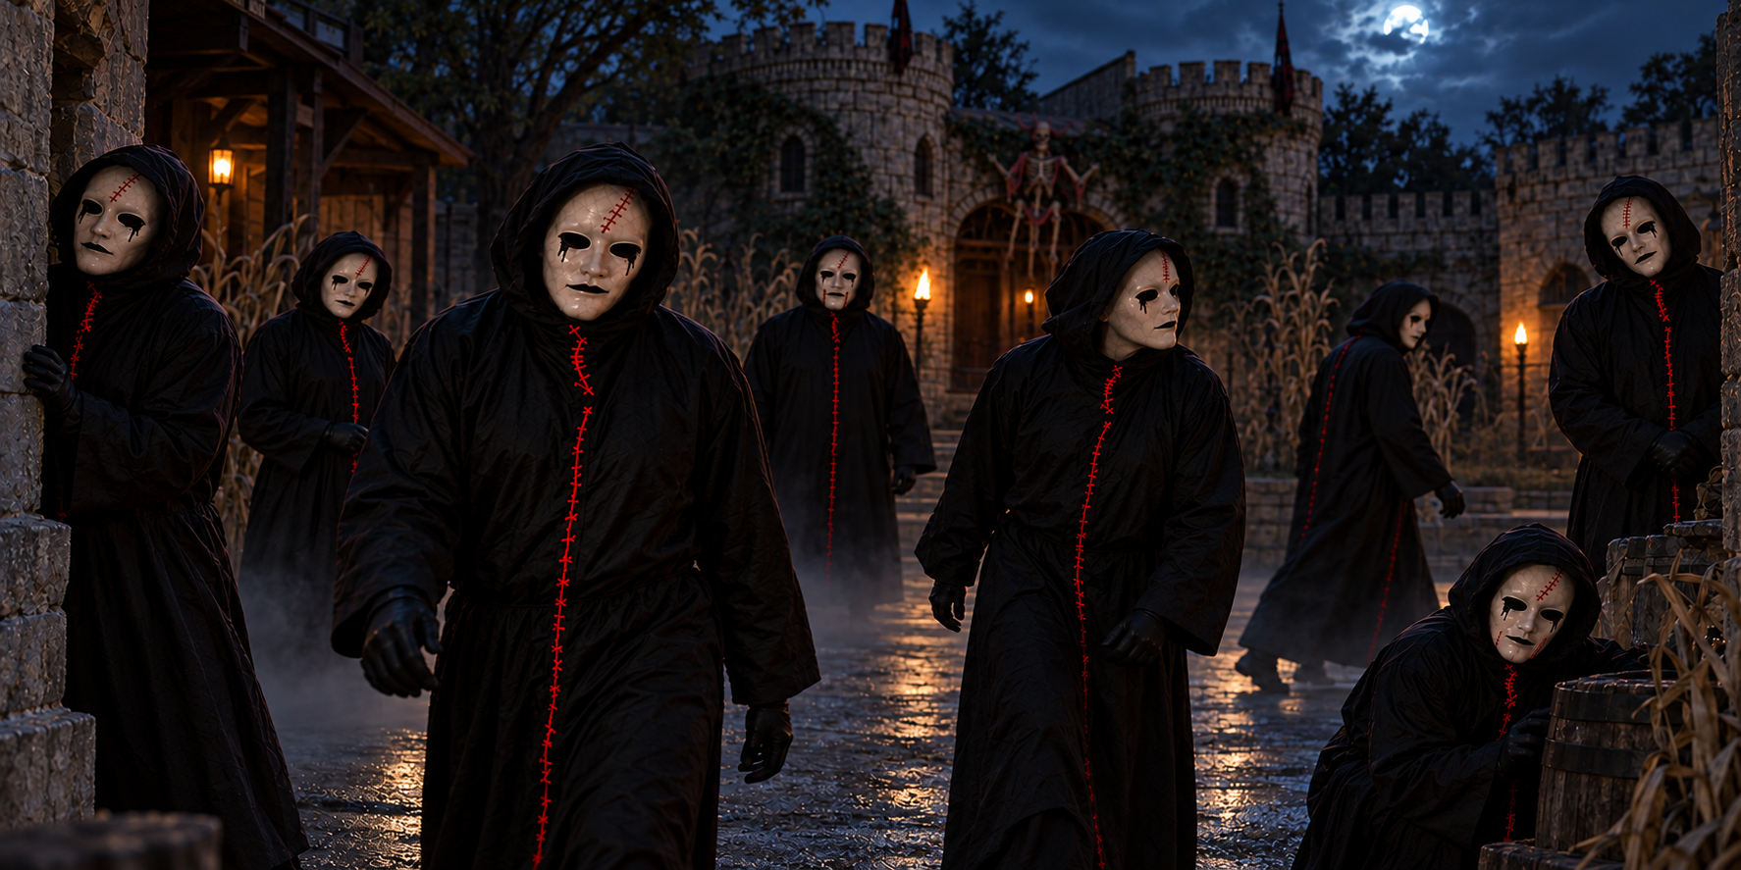
THE
RED THREADS
SIXTY HAUNTED ACRES. HUNDREDS OF COSTUMES. ONE REAL KILLER.
OG HARVE WRITER AND PRODUCER
theredthreadsmovie.com

Slide 2
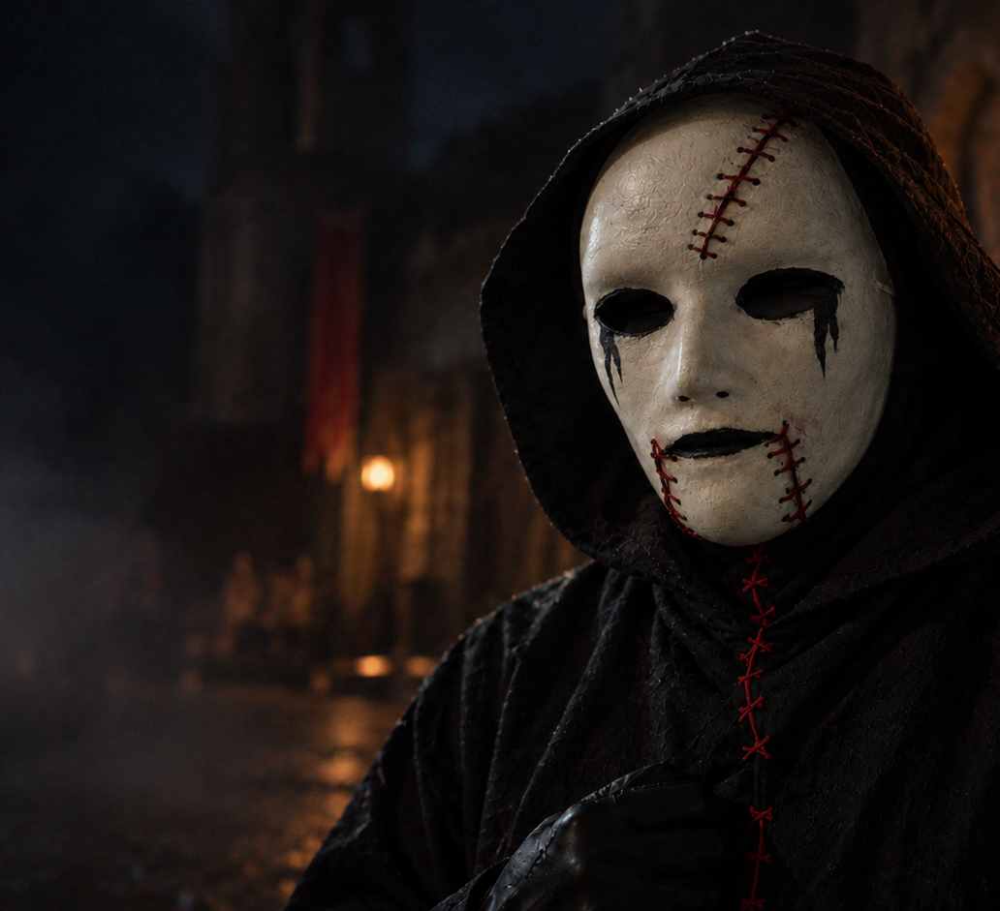
The hook
02
The crowd sees a show.
The killer sees cover.
Inside a working Halloween attraction, staged terror gives a murderer perfect cover.
theredthreadsmovie.com
REDDYHOUSE PRODUCTIONS

Slide 3
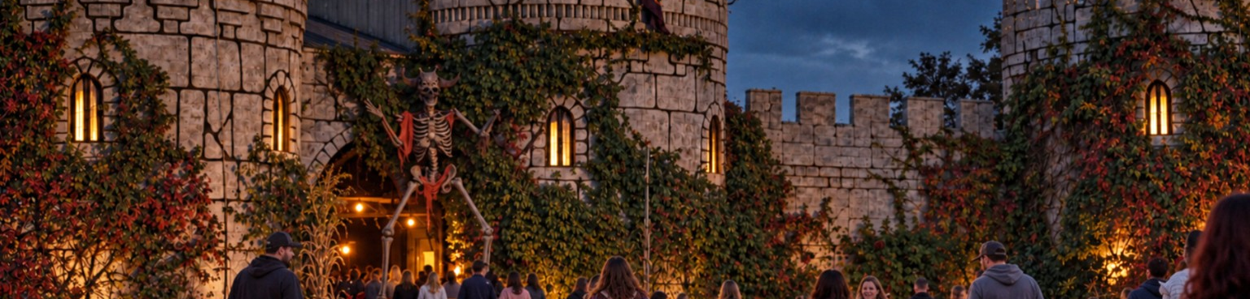
The story
03
When cash strapped friends Nate Cole and Michael Mercer take seasonal jobs at a sprawling Oklahoma haunted attraction, performers and guests begin disappearing. They realize murders are happening in plain sight while everyone around them mistakes the violence for part of the show, forcing them to identify the killer hidden among the masked cast before they become the next victims.
theredthreadsmovie.com
REDDYHOUSE PRODUCTIONS

Slide 4
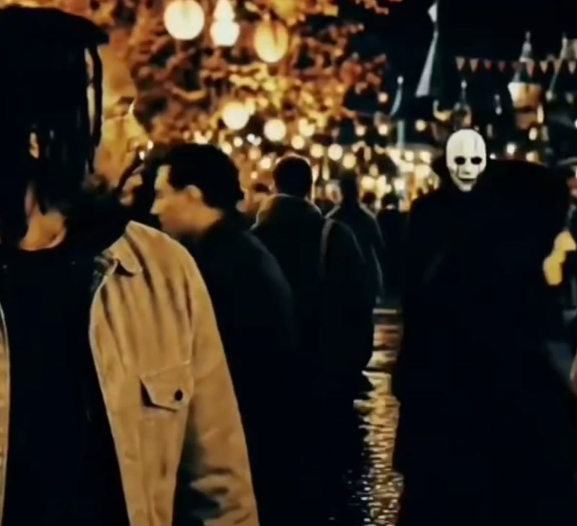
Two nights inside the haunt
04
Night one
A seasonal job becomes a crime scene nobody recognizes.
Night two
Nate and Mike return with no safe way to tell performance from murder.
theredthreadsmovie.com
REDDYHOUSE PRODUCTIONS

Slide 5
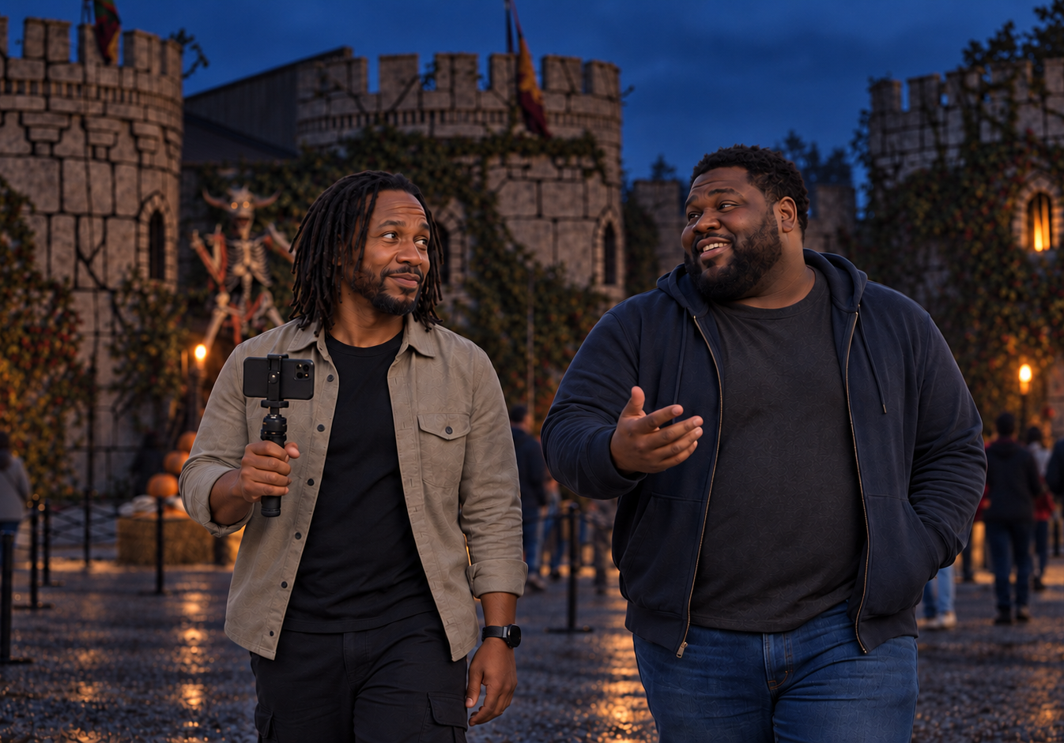
Nate and Mike
05
Nate Cole
A videographer and expectant father whose instinct to document danger pulls him deeper into it.
Michael Mercer
A singer and Red Thread performer who understands the show from inside the mask.
theredthreadsmovie.com
REDDYHOUSE PRODUCTIONS

Slide 6
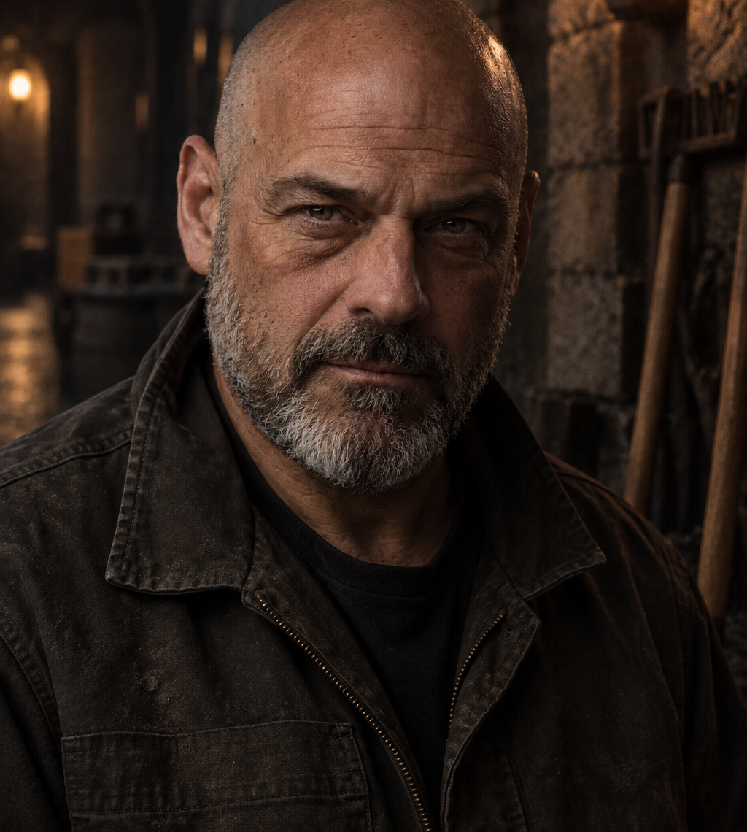
Bernie Ward
06
A quiet groundskeeper who knows every hidden corner of the haunt.
His knowledge makes him essential when the attraction becomes impossible to read.
Casting reference: PJ Sosko type
theredthreadsmovie.com
REDDYHOUSE PRODUCTIONS

Slide 7
The Red Threads
07
Seven masked performers move through the attraction. Their identical costumes turn every sighting into a question of identity.
theredthreadsmovie.com
REDDYHOUSE PRODUCTIONS

Slide 8
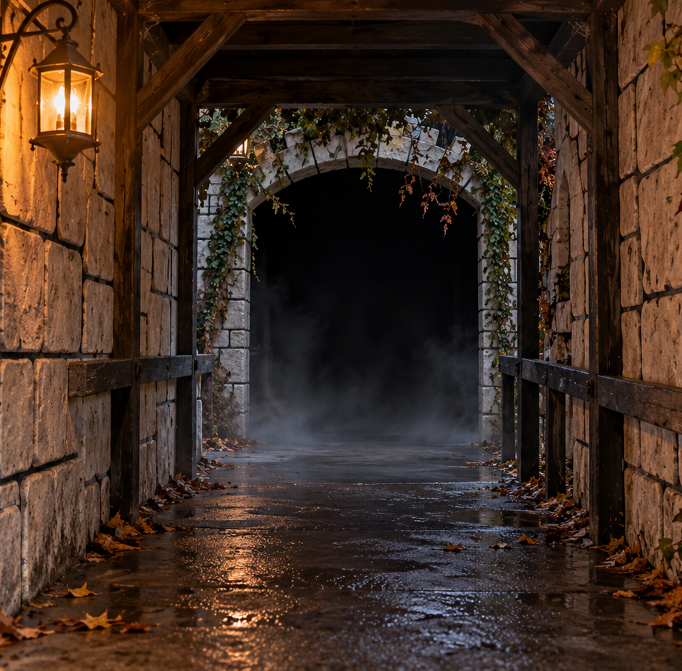
Tone and audience
08
Comparable films
Hell Fest for the attraction setting.
The Blackening for ensemble humor and character chemistry.
Scream for masked suspicion.
Audience
Horror viewers ages 18 to 39, especially slasher fans and haunted attraction audiences.
theredthreadsmovie.com
REDDYHOUSE PRODUCTIONS

Slide 9
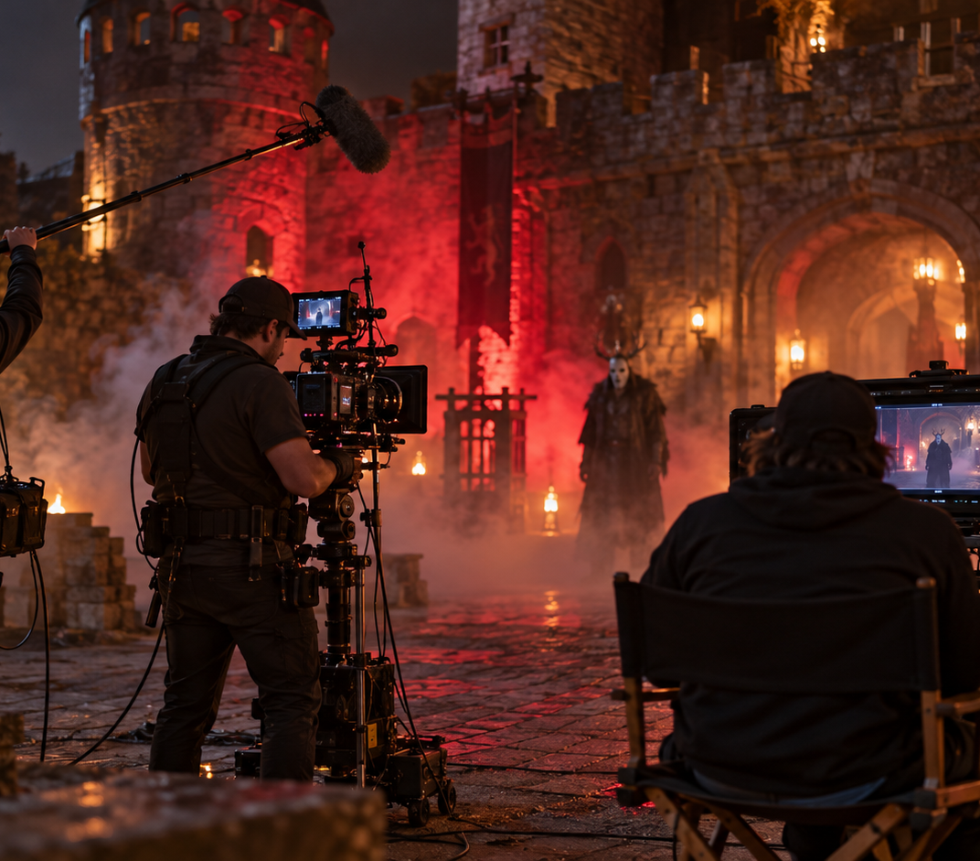
Production advantage
09
Oklahoma location
A working attraction provides practical sets, pathways, crowds and atmosphere across sixty acres.
Contained production
One property supports multiple environments and a focused production plan.
96 page screenplay. Proof of concept materials in development.
theredthreadsmovie.com
REDDYHOUSE PRODUCTIONS

Slide 10
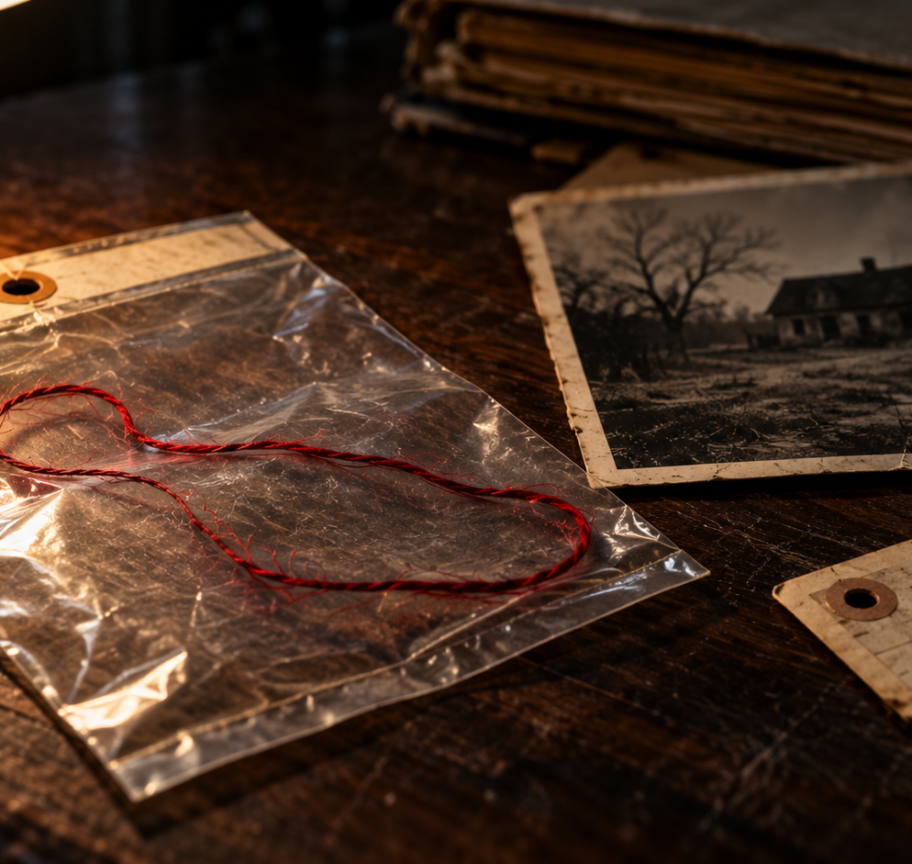
The package and ask
10
Seeking producing, financing, distribution and location partners to move the feature toward production.
OG HARVE
Writer and Producer
reddyhouseproductions@gmail.com
reddyhouseproductions.com
theredthreadsmovie.com
theredthreadsmovie.com
REDDYHOUSE PRODUCTIONS

